Slide 1
Advanced Image Processing
Dr. Rafiqul Islam
Associate Professor
Department of CSE, DUET

Slide 2
Laplacian Filtering
Development of the Laplacian method
The two dimensional Laplacian operator for continuous functions:
The Laplacian is a linear operator.

Slide 3
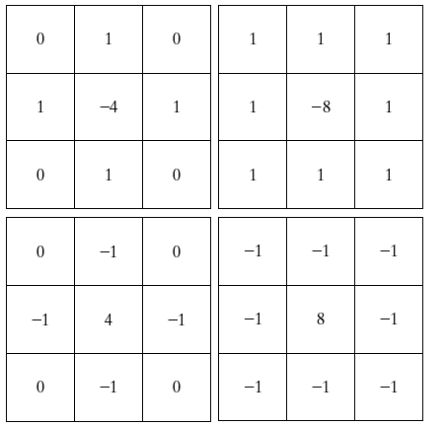
Laplacian Filtering

Slide 4
Laplacian Filtering
To sharpen an image, the Laplacian of the image is subtracted from the original image.

Slide 5
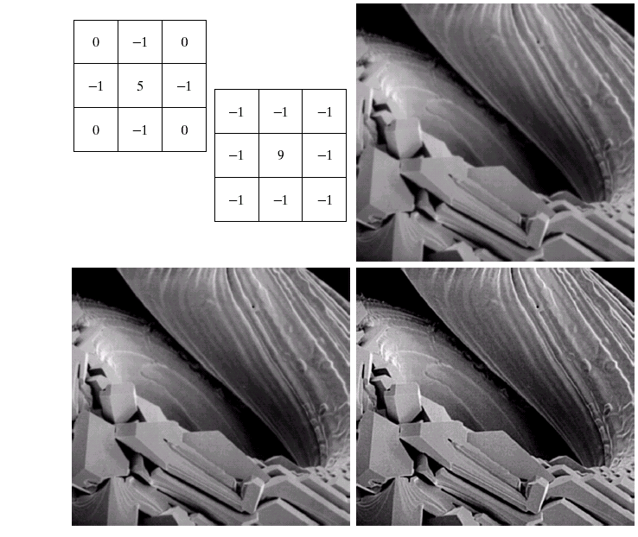
Laplacian Filtering: Simplifications
The filtering mask
Not only

Slide 6
Gradient
Development of the Gradient method
The gradient of function f at coordinates (x,y) is defined as the two-dimensional column vector:
The magnitude of this vector is given by

Slide 7
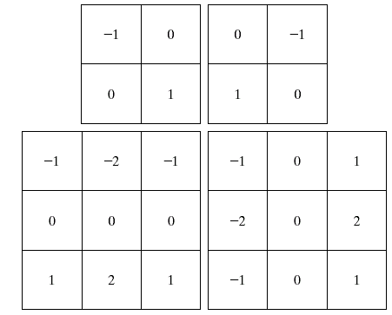
Gradient
Roberts cross-gradient
operators
Sobel
operators

Slide 8
Gradient
a = imread('cameraman.tif');
h = [-1 0 1;-2 0 2;-1 0 1];
b = imfilter(a,h,'same');
figure, imagesc([a b]), colormap(gray)

Slide 9
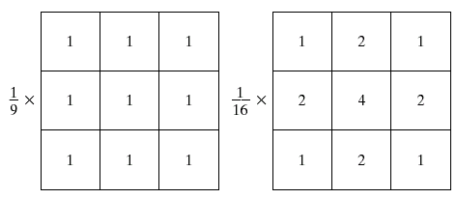
Smoothing Filtering
Smoothing
Averaging filters (Low pass filters)
Box filter
Weighted average filter
Box filter
Weighted average

Slide 10
Smoothing Filtering
a = imread('cameraman.tif');
h = [1 1 1;1 1 1;1 1 1]/9;
b = imfilter(a,h,'same');
figure, imagesc([a b]), colormap(gray)

Slide 11
Frequency Domain Processing
The foundation of frequency domain techniques is the convolution theorem
Reduce Computation cost

Slide 12
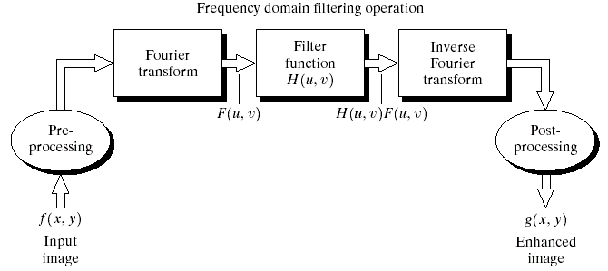
Frequency Domain Processing
H(u, v) is called the transfer function

Slide 13
Frequency domain Filtering
a = imread('cameraman.tif'); a_fft = fft2(a);
h = [-1 0 1;-2 0 2;-1 0 1]; [m,n] = size(f);
h(m,n)=0;
F = fft2(f); H = fft2(h);
F_fH = H.*F; ffi = ifft2(F_fH);
figure(1), imagesc(abs(ffi));

Slide 14
Noise
Gaussian-
Uniform-
Salt and Pepper-

Slide 15
Other noise
Rayleigh Noise
Gamma Noise
Exponential Noise

Slide 16
Gaussian noise
Noise arise during acquisition. The sensor has inherent noise due to the level of illumination and its own temperature, and the electronic circuits connected to the sensor inject their own share of electronic circuit noise.
Electronic circuit noise and sensor noise
mean
variance
Note:

Slide 17
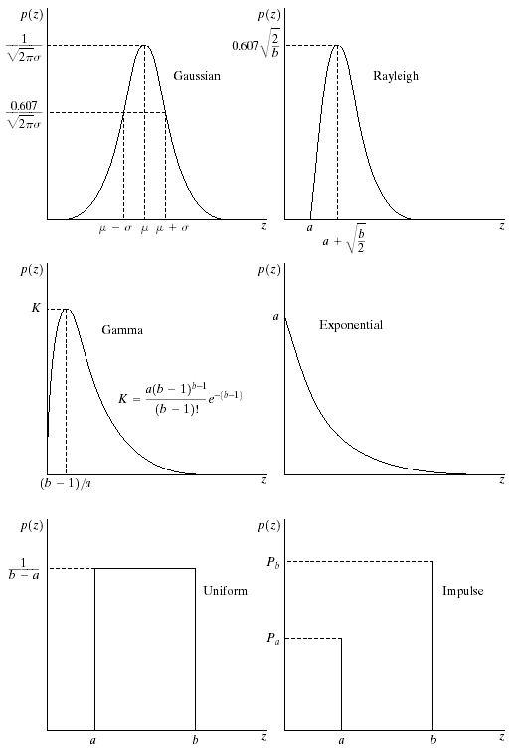
Gaussian noise (PDF)
70% in [(μ−σ), (μ+σ)]
95% in [(μ−2σ), (μ+2σ)]

Slide 18
Uniform noise
Less practical, used for random number generator
Mean:
Variance:

Slide 19
Uniform PDF

Slide 20
Impulse (salt-and-pepper) Noise
Quick transients, such as faulty switching during imaging
If either P_{a} or P_{b} is zero, it is called unipolar.
Otherwise, it is called bipoloar.
In practical, impulses are usually stronger than image
signals. Ex., a=0(black) and b=255(white) in 8-bit image.

Slide 21
Impulse (salt-and-pepper) nosie PDF

Slide 22
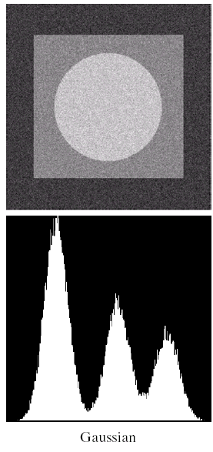
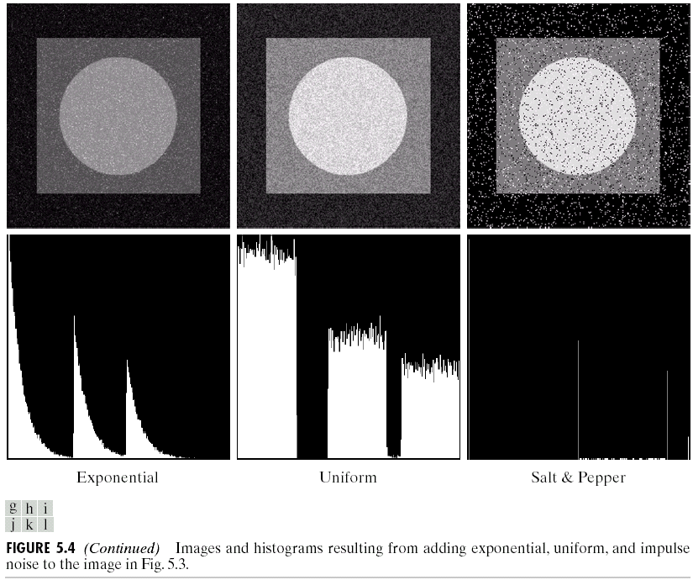

Slide 23
Radon transform
CT – Computer Tomography
MRI – Magnetic Resonance Imaging
PET – Positron Emission Tomography
SPECT – Single Photon Emission Computer Tomography

Slide 24
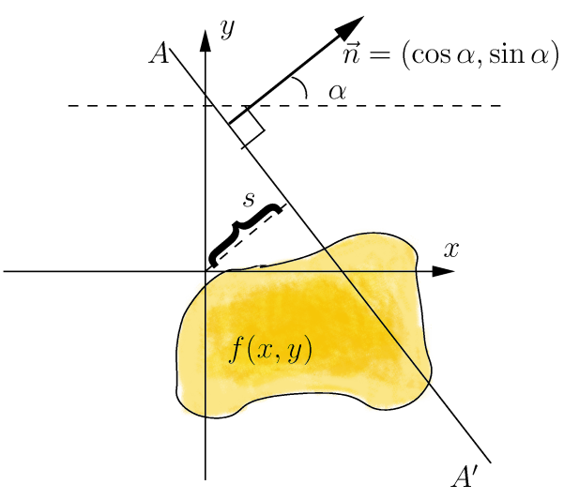
Geometry of 2D Radon transform
Input space coordinates x, y
Input function f(x, y)
Output space coordinates a, s
Output function F(a, s)

Slide 25
Theory of pure RT and IRT
Radon transform
Inverse Radon transform

Slide 26
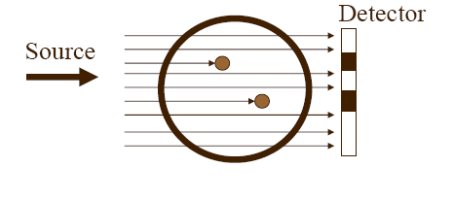
Radon Transform
Example

Slide 27
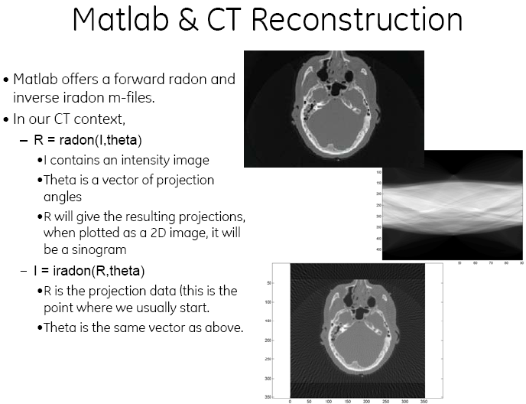
Radon Transform in Matlab
sinogram

Slide 28
Discrete Cosine Transform
DCT is similar to the Fast Fourier Transform (FFT), but can approximate lines well with fewer coefficients
Used in JPEG and MPEG
Another Frequency Transform, with Different Set of Basis Functions

Slide 29
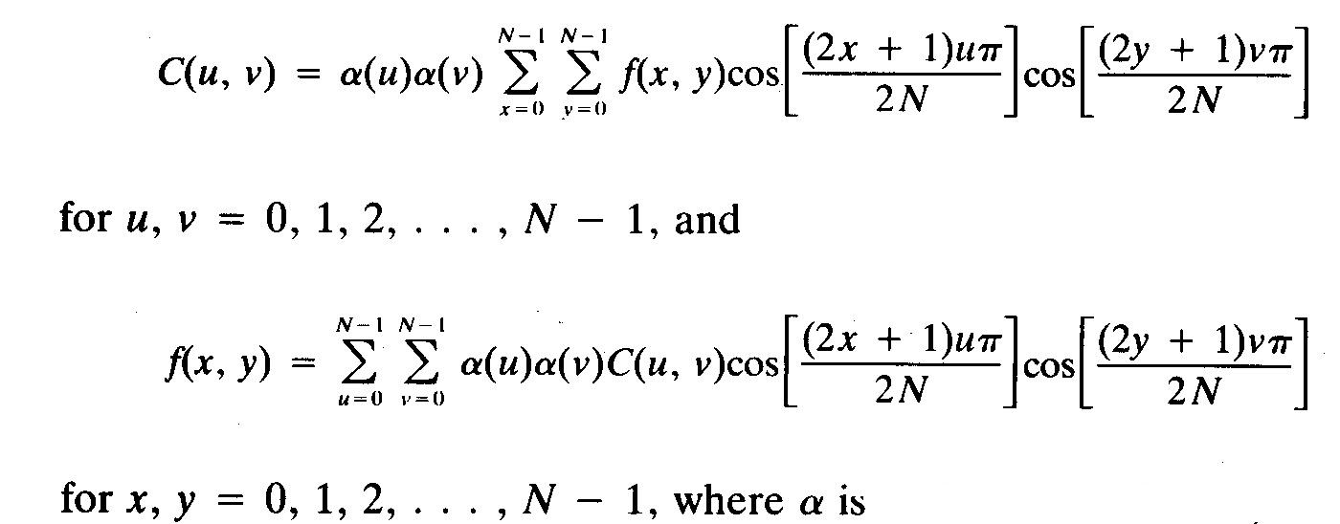
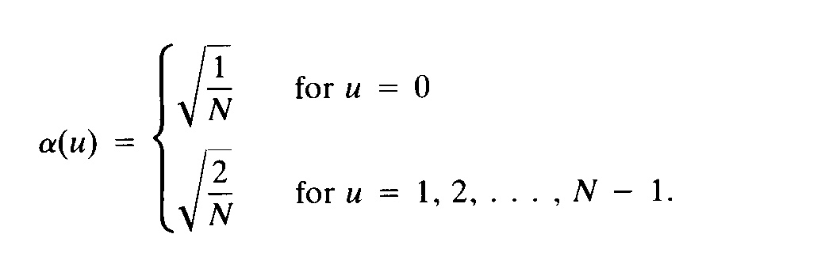
Discrete Cosine Transform

Slide 30
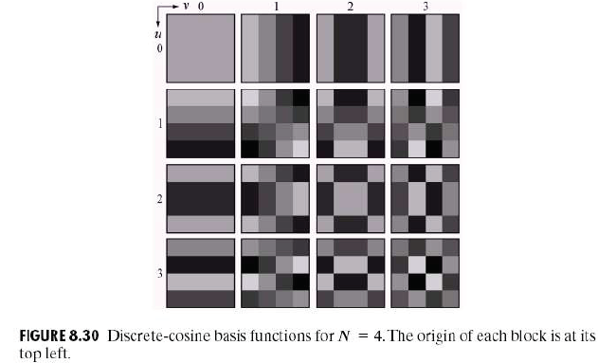
Discrete Cosine Transform
Each block consists of 4×4 elements, corresponding to x and y varying from 0 to 3. The highest value is shown in white. Other values are shown in grays, with darker meaning smaller.

Slide 31
Discrete Cosine Transform
Example
Main Image (Gray Level)
DCT of Main image
(Cosine spectrum)

Slide 32
Discrete cosine transform
Matlab Code for DCT
>> a=imread('cameraman.tif');
>> b = dct2(a);
>> figure(1), imshow(a), colormap(gray)
>> figure(2), imshow(b), colormap(gray)

Slide 33
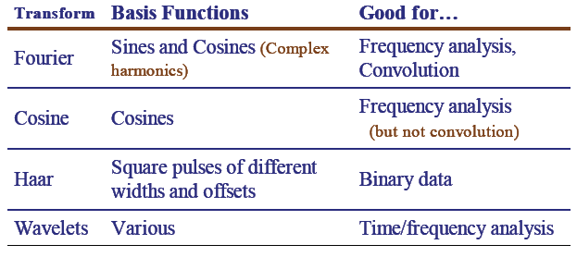
Comparison Of Various Transforms

Slide 34
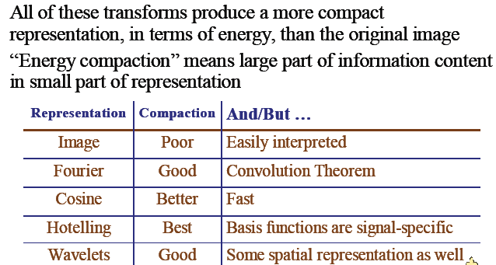
Comparison Of Various Transforms

Slide 35
Project
Skin Cancer Detection
Blood cell classification
Tools: Matlab/Python
Algorithm: CNN, DL, etc.
Image Reconstruction from few data
Application: CT, MRI, UI, ECG, etc.
Tools: Matlab/C/C++
Theme: Compressed Sensing

